Slide 1

Become a key opinion editor in 10 minutes
「10分钟让你成为科技媒体网红小编」
Our group has crawled over 20,000 articles from a website called "Everyone is a Product Manager" to explore the relationship between article titles and their popularity...

Slide 2

1
BACKGROUND
CONTENTS
2
WHY？
3
WHAT?
4
HOW?
5
SUMMARY

Slide 3
01
Background
PART

Slide 4

Background
Product Manager
Internet Community - Content - Community - Education
More than 3 million loyal fans
3,000 professional authors
500 senior industry mentors
Goods Articles, Interactive Questions and Answers, Online Lectures, Offline Activities, and Professional Courses for Study.
Hot Topic in Recent Year

Slide 5
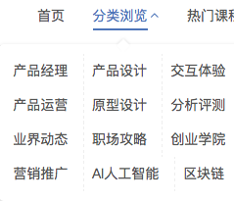
Analysis content
12 Section
20000 articles
Favorites
Likes
Popular Author
What kind of articles are popular
Article Title
The relationship between title’s length and popularity
Hot topic
Operating, Technology, Entrepreneurship

Slide 6
02
Analysis Tool
PART

Slide 7
Analysis Tool
Jieba
Python 3.6
Selenium
Our efforts
Pyecharts

Slide 8
03
Data Crawling
PART

Slide 9
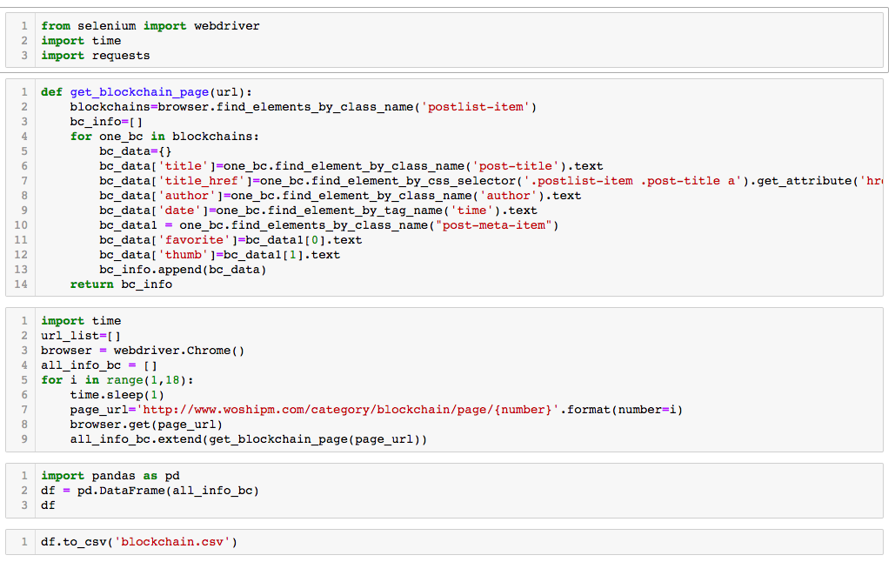
Browser Automation
Selenium
Scrape
For Loop
Save

Slide 10
04
Data Analysis
PART

Slide 11
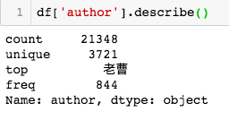
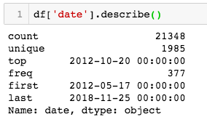
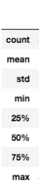
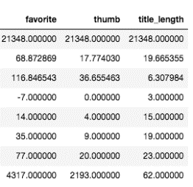
Data Analysis
3721 Author
21348 Articles
2012-10-20
Published 377 Article
Less ‘Favorite’ & ‘Thumb’

Slide 12
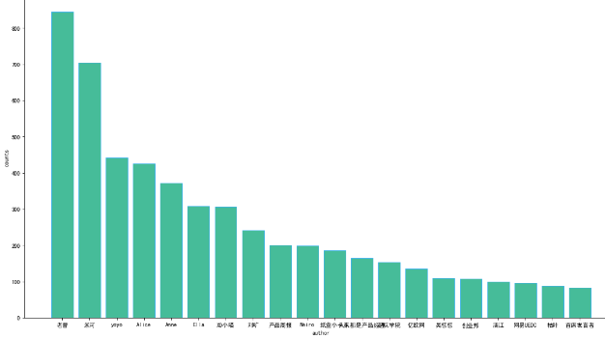
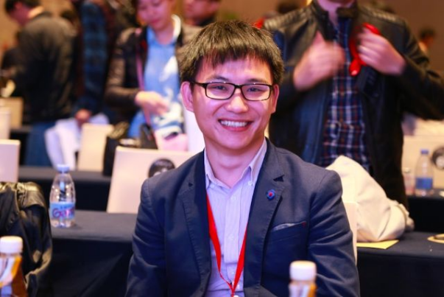
Top 20 High Output Author
Who is 老曹？？？
winner:老曹

Slide 13
Data Analysis
Does more articles mean more favorites?

Slide 14
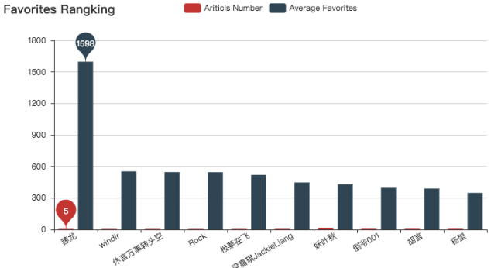
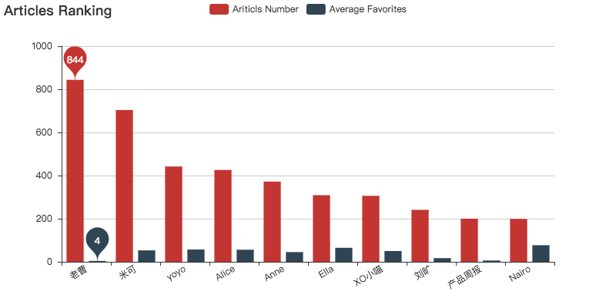
Data Analysis
Few Articles
More Favorites
More Articles
Less Favorites

Slide 15
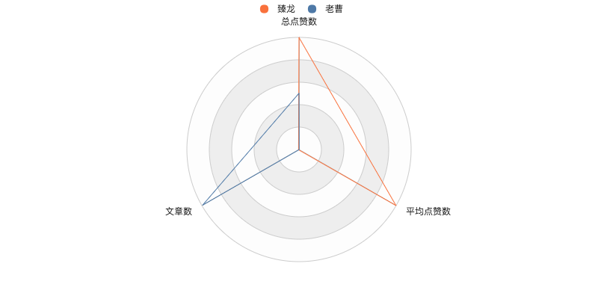
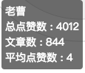
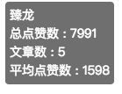


Data Analysis
Does more articles mean more favorites?
- No

Slide 16
04
Writing Skills
PART

Slide 17

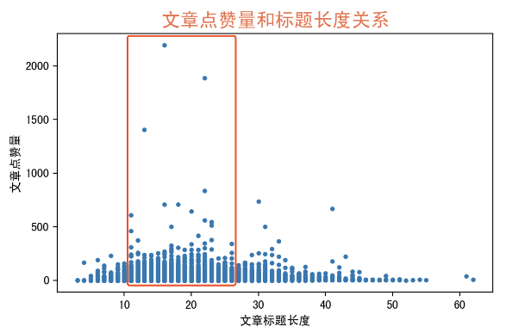
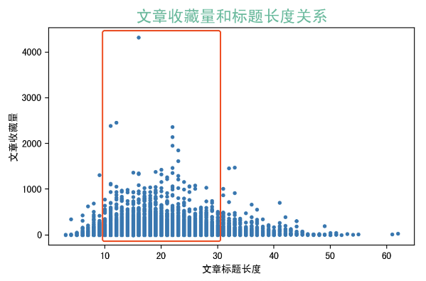
Data Analysis
A good title helps a lot
- Majority length of titles [10,30]
- Length around 20 gain more favorites and thumbs.

Slide 18
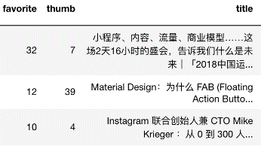
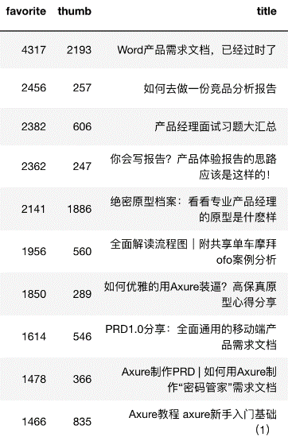

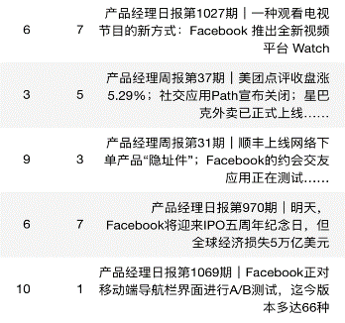

- News articles - information
- Long title less
- Practical articles - skills and opinions
- Suitable title more

Slide 19
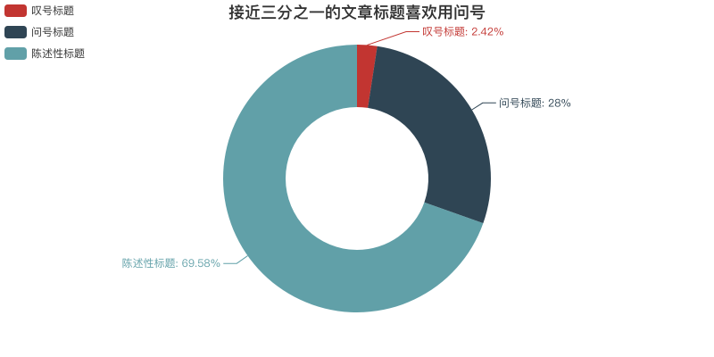


Data Analysis
Punctuation of titles can be diversified.

Slide 20
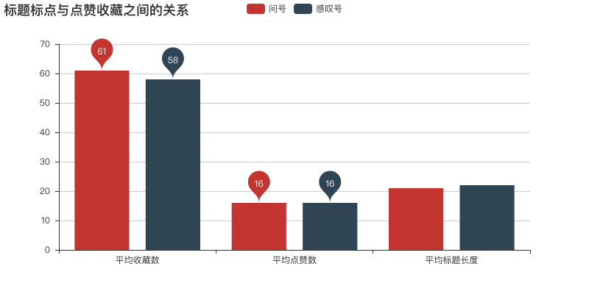

Data Analysis
Whether you would gain more attractions?
- It depends, but NOT in this website.

Slide 21
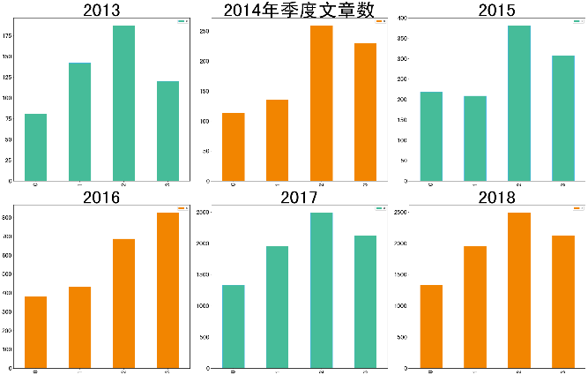
Data Analysis
A good timing is also important
Quarter 3 ranks the top 5 times in 6 years.

Slide 22
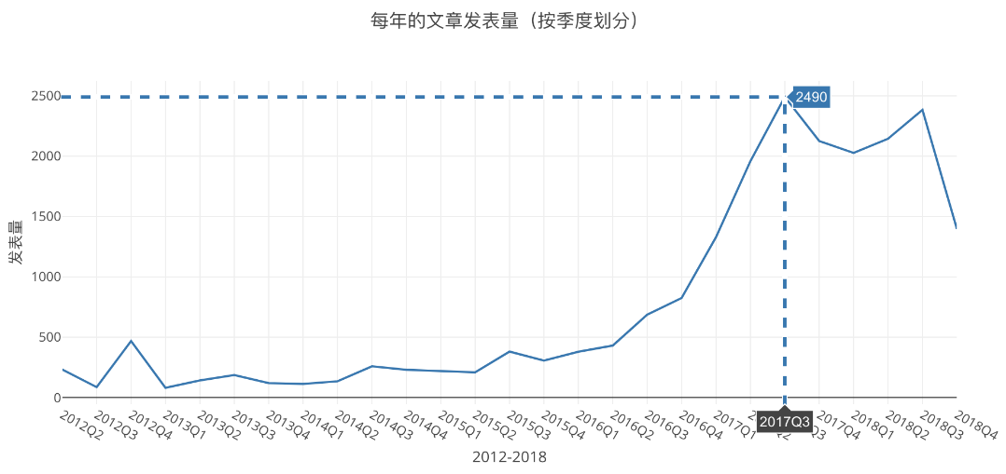
Data Analysis
Grow rapidly from 2016 and reach its peak at quarter 3 in 2017

Slide 23

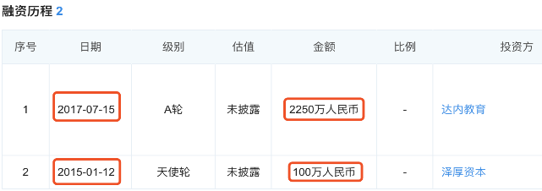

Data Analysis
Enterprise Financing
Cooperative Partnership
2016年7月，荣获腾讯课堂“TOP计划”首批认证机构，并与腾讯课堂就IT互联网-互联网产品、运营领域达成战略合作，联合推出“腾讯课堂产品学院”，强强联合，共同在互联网产品、运营领域拓展更多更优质的教学内容及创新教学模式。

Slide 24
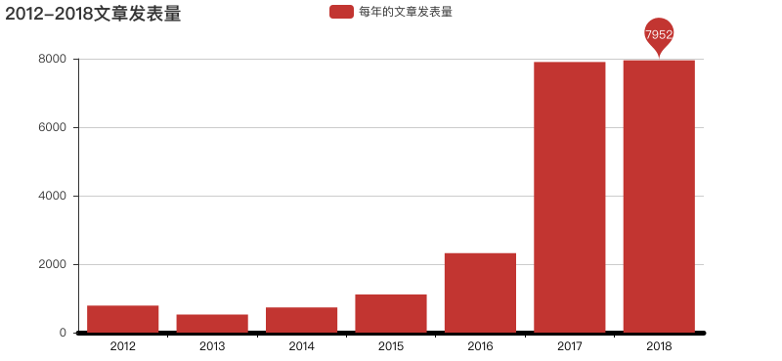
Data Analysis
The number of published articles has increased and stabilized .

Slide 25
05
Data Analysis
of articles in 12 different sections
PART

Slide 26
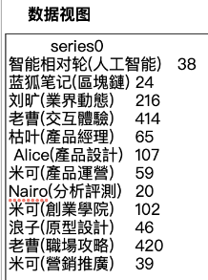
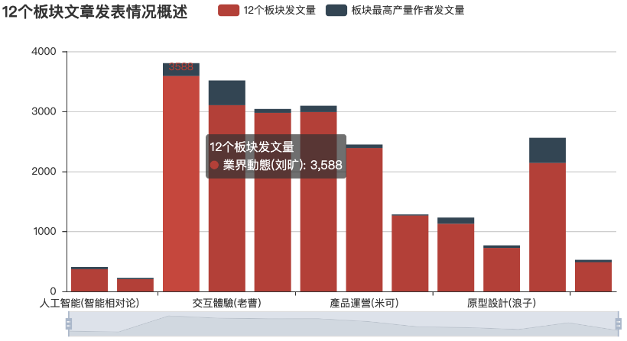
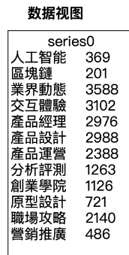
Data Analysis

Slide 27
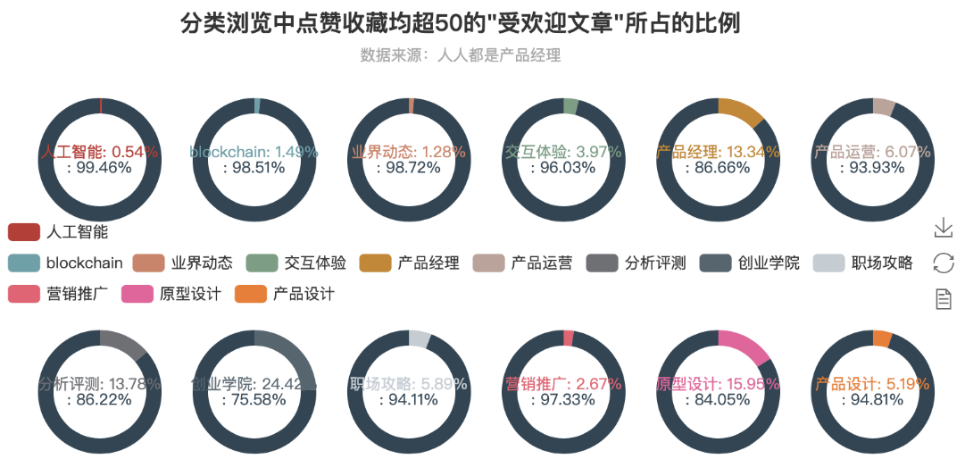
Data Analysis

Slide 28
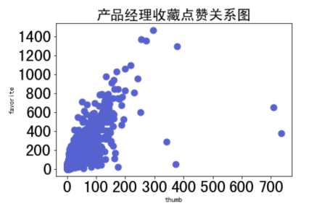
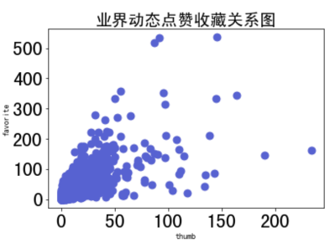
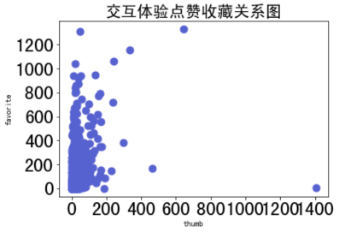
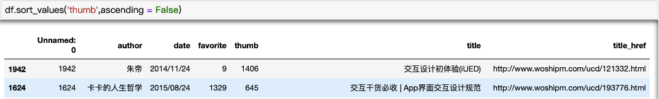
Data Analysis

Slide 29

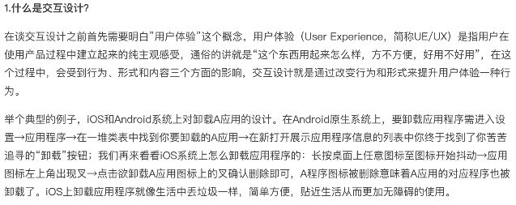
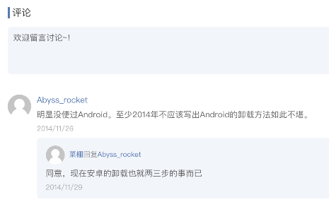
Data Analysis

Slide 30
06
SUMMARY
PART

Slide 31
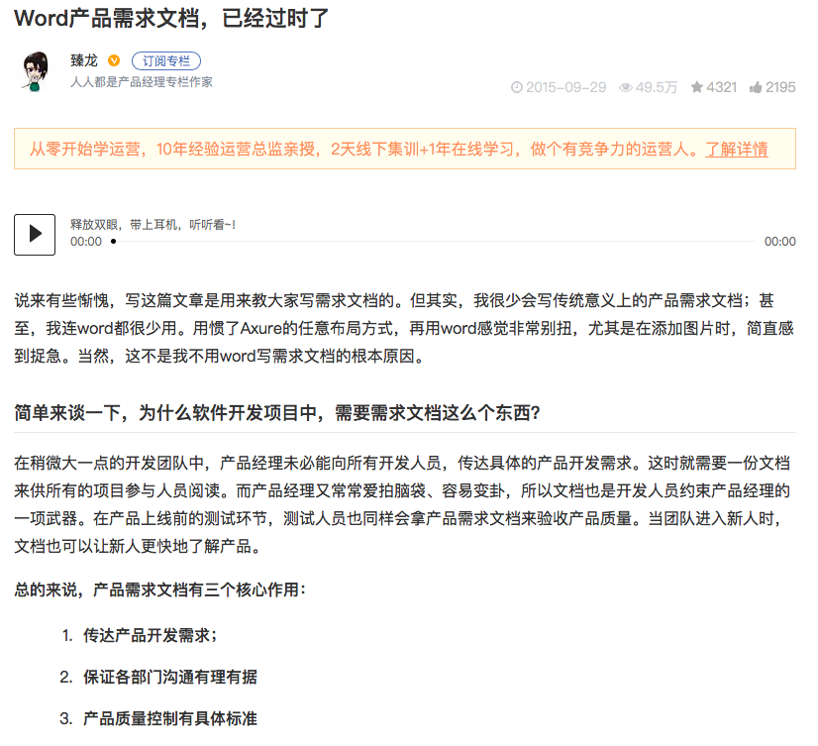
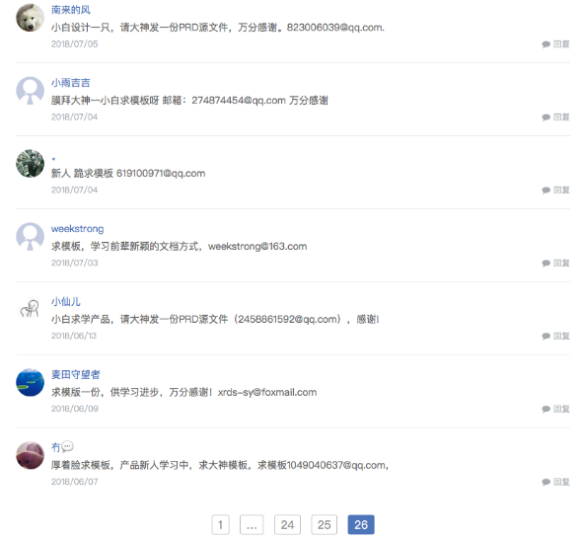
SUMMARY

Slide 32

word cloud
网易

Slide 33
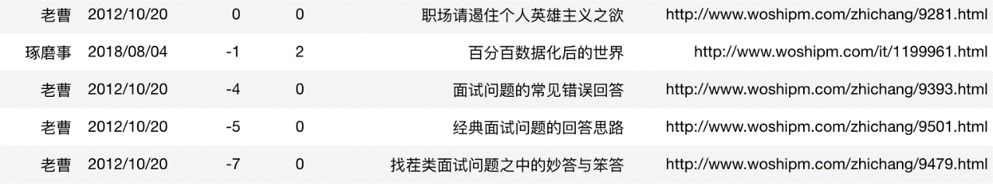

BUG of What We Found
Sort by favorite, there are 4 negative number
《找茬类面试问题之中的妙答与笨答》 date: 2012-10-20

Slide 34
THANK YOU
Pili we love you !!!
2018-12-07

